Slide 1

AI Agents - 101

Slide 2

Agenda
The State of AI in Industry
Q&A + Discussion
AI Agents Workshop
AI Agents 101

Slide 3

About Me
Data Architect @ Plains Midstream Canada
Founding Engineer @ Code To Cloud
Databricks MVP
7+ years in various industries including energy, financial tech, and airlines holding various roles:
Cyber Security
DevOps Specialist
Software Developer
Data Engineer
Data Architect

Slide 4
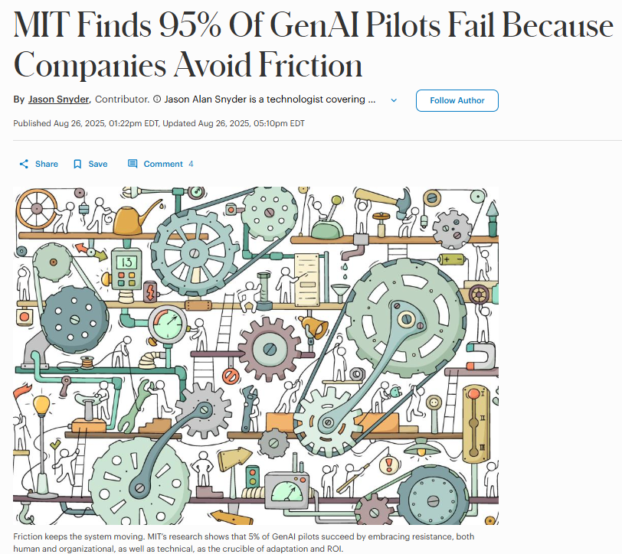
AI Projects Are Failing…

Slide 5
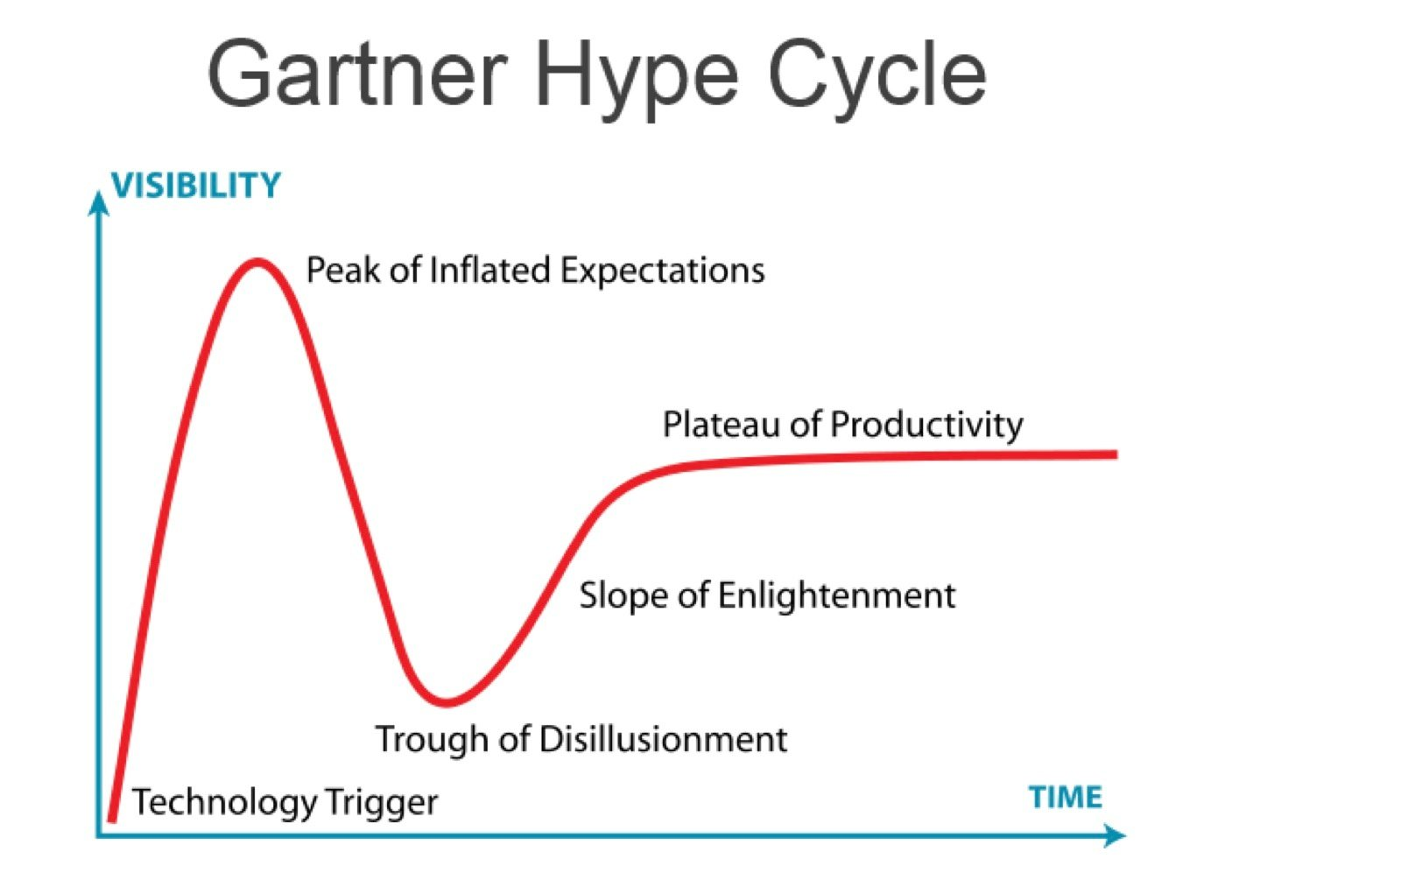
The Technology Hype Cycle

Slide 6



AI Use Cases Use Cases I am seeing in the energy space
Document Intelligence
Intelligent Maintenance Management
Anomaly Detection
Primarily around extracting salient information for contracts
Evaluating work order & incident trends at scale
Detecting anomalies on assets on site

Slide 7







AI Prerequisites Requirements for a successful AI project, explained as an analogy
AI as the Engine, Data as the Fuel
Mechanic
Data
Fuel
Algorithms/Models
Engine Design
Deployment
Road/Destination
Human Expertise
Driver/Mechanic
Driver

Slide 8






Everyone is a programmer/coder
A new wave of AI tools are enabling the next generation developers
I want to automate the creation of our requirements document
…
…
AI Assistant
Stakeholder
AI Agent App
Meeting Transcript
AI Requirements Doc
Shawn records meetings with stakeholders during discovery sessions
Manual review of recording to compile a requirements document
With the help of AI tools, Shawn was able to:
Create an AI agent
Build a frontend application for the agent
Deploy to production
Final product,
Shawn can upload a meeting transcript
AI Agent will analyze the transcript
AI Agent will output a highly structured requirements doc detailing the ROI, business case etc.
Shawn Moghaddami is a Business Analyst at Plains Midstream
Haskayne Graduate
MBA Background

Slide 9
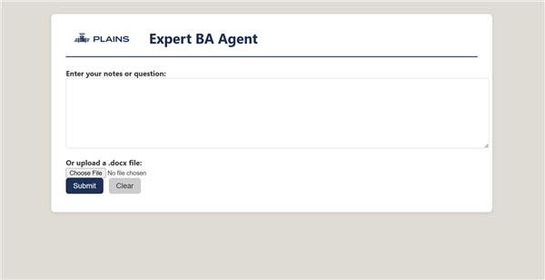

Slide 10





What is an AI Agent?
The components that make up an Agent
Input
Agent
Output
LLM (The Brain)
Instructions
User Messages
Agent Messages
Tools
Agent Messages
User Messages
Tools can be called n number of times
Tools
Retrieval
Actions
Memory

Slide 11
The Complex Reality of AI Agents
The barrier to deploy production AI agents is still high
How do I evaluate the quality of these outputs??
How will I continuously improve this Agent??
How will I serve this to my end users??
What if I change my LLM??
Agent
Input
Output
LLM (The Brain)
Instructions
User Messages
Agent Messages
Tools
Agent Messages
User Messages
Tools
How do I secure the data that the Agent has access to??
How do I monitor my app??
Retrieval
Actions
Memory

Slide 12



AI Agent Patterns
The most common design patterns for agents
Chain/Retrieval Augmented Generation (RAG)
Information Extraction
Multi-Agent Supervisor
A predefined sequence of steps, like retrieving relevant context and combining it with a prompt. The LLM does not decide what to do. The workflow is fixed.
Transforms unstructured text into structured output
Multiple specialized agents collaborate. A coordinator decides which agent handles which part of the task and manages hand-offs to maintain overall flow.

Slide 13

AI Agent Patterns - Chain/RAG
The most common design patterns for agents
Some super specific question about your company
Retrieval Augmented Generation
A
G
R
User
Agent
Your Companies Database

Slide 14

AI Agent Patterns - Information Extraction
The most common design patterns for agents
I want start date, end date, and vendor to be extracted
User
{
start_date: 2025-10-30
end_date: 2026-06-28
vendor: Databricks
}
Agent
Vendor Contract

Slide 15






AI Agent Patterns - Multi-Agent Supervisor
The most common design patterns for agents
RAG
Some super complicated task
Agent #1
Database #1
Supervisor Agent
Agent #2
RAG
Send Email
Agent #3
Database #2

Slide 16
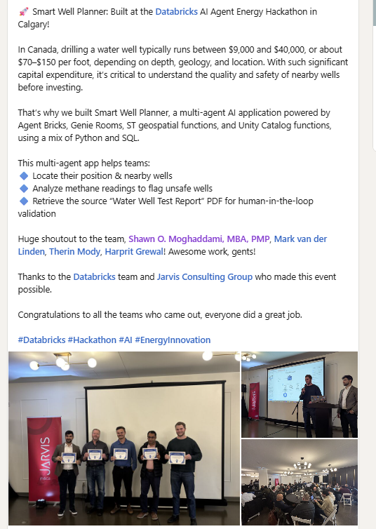
A Real-World Example of a Multi-Agent Design
Built at Databricks AI Agent Energy Hackathon, Calgary
Purpose: Reduce drilling risk for costly water wells ($9k–$40k / $70–$150 per foot)
Capabilities:
Locate your position & nearby wells
Analyze methane readings to flag unsafe wells
Retrieve Water Well Test Report PDFs for human-in-the-loop validation

Slide 17

Databricks Overview What is Databricks?
A data and AI platform used to turn raw data into business insights
Provides a shared workspace for analytics, data engineering, and AI
Helps teams collaborate instead of working in isolation

Slide 18
Important Technical Vocabulary Important terms you need to know to get started
OCR (Optical Character Recognition): Technology that converts printed or handwritten text in images or PDFs into machine-readable text for data processing.
Volume: In Databricks, a Volume is a storage location within a catalog where files (like CSVs, images, or PDFs) can be organized and accessed securely by users or notebooks.
Unity Catalog: A centralized governance layer in Databricks that manages data access, permissions, and metadata across all data assets in your organization.
SQL (Structured Query Language): A programming language used to store, manage, and retrieve data from relational databases by writing queries.

Slide 19
AI Agent Workshop Learning Objectives What you can expect to learn
Understand the importance of good quality data
How to leverage AI to enrich data
Build & interact with AI Agents
Leverage AI Assistants to Code

Slide 20





AI Agent Workshop Use Case The use case we are working towards
Learning Objective: How to leverage AI to enrich data
Movie Database
User
Bronze
Silver
Gold
IMDb Movie PDFs
OCR Movie PDFs
Enriched Data with AI
AI Agent
Learning Objective: Leverage AI Assistants to Code
Learning Objective: Build & interact with AI Agents
Learning Objective: Understand the importance of good quality data

Slide 21

Lessons Learnt What did we learn today?
Can you think of areas where this could be applied?
What was your biggest takeaway?

Slide 22




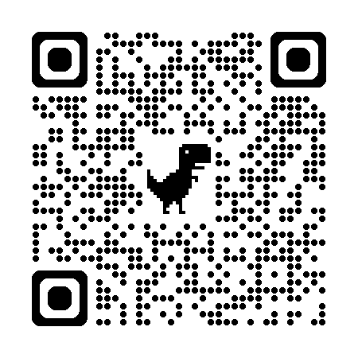

Connect With Me! Any Questions?
Code To Cloud
LinkedIn
Personal Blog

